Slide 1
See what we SPIN’d up for you!

Slide 2
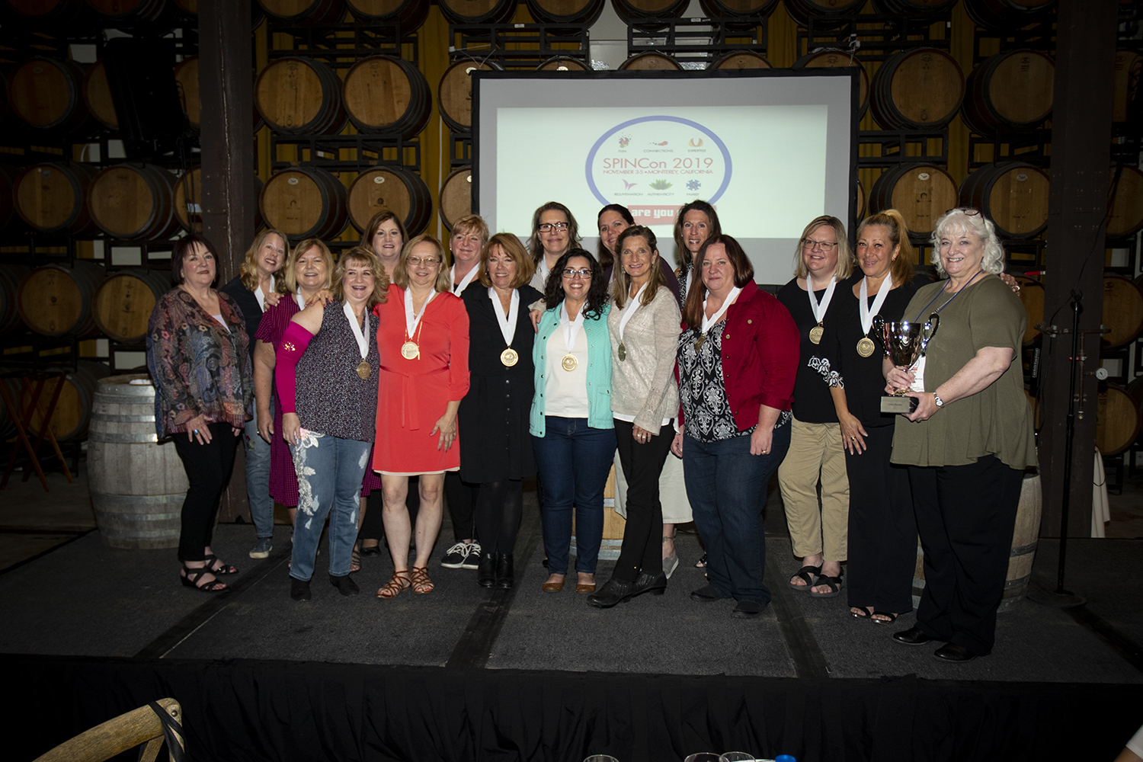
SPIN 2022 Sponsorship Prospectus
SPIN is an experience like no other. Our members are senior-level within the industry (they’ve seen it and done it all!). They have a global reach and collectively engage with others in the industry to bring their top skills and A-game to each of their clients.
As a SPIN Sponsor we look forward to helping you GROW YOUR BUSINESS with access to the top planners within the industry. Our members run the gamut: corporate, association, independent, SMERF, gov’t and nonprofit planners.

Slide 3
Benefits and Services
$4,000 YEAR-LONG SPONSORSHIP
$7,500 YEAR-LONG SPONSORSHIP (Can be shared*)
$10K YEAR-LONG SPONSORSHIP (Can be shared*)
One registration to SPINCon 2022
Membership in the Facebook “Members Only” group for 1 full year
One email blast sent to Full Membership anytime in 2021 (2000+ recipients)
One ad in the header photo area atop the Facebook group page for 3 days (1,000 members) – NEW!
One ad in a SPIN newsletter (2000+ recipients plus 30 days on website)
Listed on the SPIN website for a full year with a 50-word description, logo and two contacts name/phone/email
Listed in the new SPIN Preferred Supplier Directory sent 1x per year to all members – NEW!
‘SPIN Preferred Supplier’ logo for your use
TWO registrations to SPINCon 2022
TWO membership in the Facebook “Members Only” group for 1 full year
TWO email blasts sent to Full Membership anytime in 2021 (2000+ recipients)
TWO ads in the header photo area atop the Facebook group page for 3 days (1,000 members) – NEW!
TWO ads in a SPIN newsletter (2000+ recipients plus 30 days on website)
Listed on the SPIN website for a full year with a 100-word description, logo and FOUR contacts name/phone/email
Listed in the new SPIN Preferred Supplier Directory sent 1x per year to all members – NEW!
‘SPIN Preferred Supplier’ logo for your use
THREE registrations to SPINCon 2022
THREE membership in the Facebook “Members Only” group for 1 full year
THREE email blasts sent to Full Membership anytime in 2021 (2000+ recipients)
THREE ads in the header photo area atop the Facebook group page for 3 days (1,000 members) – NEW!
THREE ads in a SPIN newsletter (2000+ recipients plus 30 days on website)
Listed on the SPIN website for a full year with a 100-word description, logo and FOUR contacts name/phone/email
Listed in the new SPIN Preferred Supplier Directory sent 1x per year to all members – NEW!
‘SPIN Preferred Supplier’ logo for your use
*These packages can be split with other organizations to reduce your investment!

Slide 4
SPIN Sponsorship Agreement
This Agreement is between The Planner Networks, LLC (dba SPIN:Senior Planners Industry Network) with offices at 2211 Marilyn Avenue Eagan, MN 55122 (“SPIN”) and “Sponsor” listed below.
Terms
This agreement is in effect for one year from the date full payment is received. Unused benefits are forfeited at the end of Sponsor’s enrollment year. Exception: If SPIN is unable to fulfill any benefits through no fault of Sponsor, such benefits will be rolled over to the next year until fulfilled, or will be substituted with other benefits as mutually agreed upon by both parties.
SPONSOR WHO WILL BE THE PRIMARY SPIN MEMBER:
Name:
Email:
Phone:
Please provide a contact to fulfill any marketing items if different from primary contact.
Name:
Email:
Phone:
Accepted and agreed to terms and conditions: For Sponsor:
Name: Date:
Company: Signature:
For SPIN: Date: Shawna Suckow, Founder SPIN

Slide 5
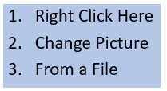
Please provide the following information according to your Sponsorship Level.
Provide 50 - 100 words for the advertisement on the SPIN Website & Preferred Supplier Directory (per your Sponsorship allotment)
Click to input here:
Provide Contact information for your Organization (per your Sponsorship allotment)
Contact | Name | Email | Phone 123-456-7890
#1
#2
#3
#4
Please click the link below and answer ALL THREE questions for access to the SPIN Members Only Facebook Group:
https://www.facebook.com/groups/SPINprofs
Please insert your latest LOGO here

